Slide 1

Application of Image Processing In Streaming Platforms
Gaurav Rai
1706019
gauravr.ug17.cs@nitp.ac.in

Slide 2

How Netflix uses Image Processing Techniques ?
Netflix uses various Image Processing Techniques to give a smooth & unparalleled User Experience to its viewers.
Some of them are :
Text Placement
Focal Point Algorithm to find most interesting part of an image.

Slide 3
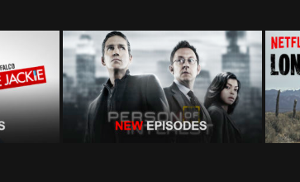
Text Placement
Determining what would be the best place to put text on an image.
Examples include ‘New Episode’ Badge and placement of subtitles in a video frame..
Several transformations are also
applied like edge detection,
Thresholding etc.
Transformations help to get
fairly accurate probability of
text in a ROI for image in large
corpus of images.

Slide 4
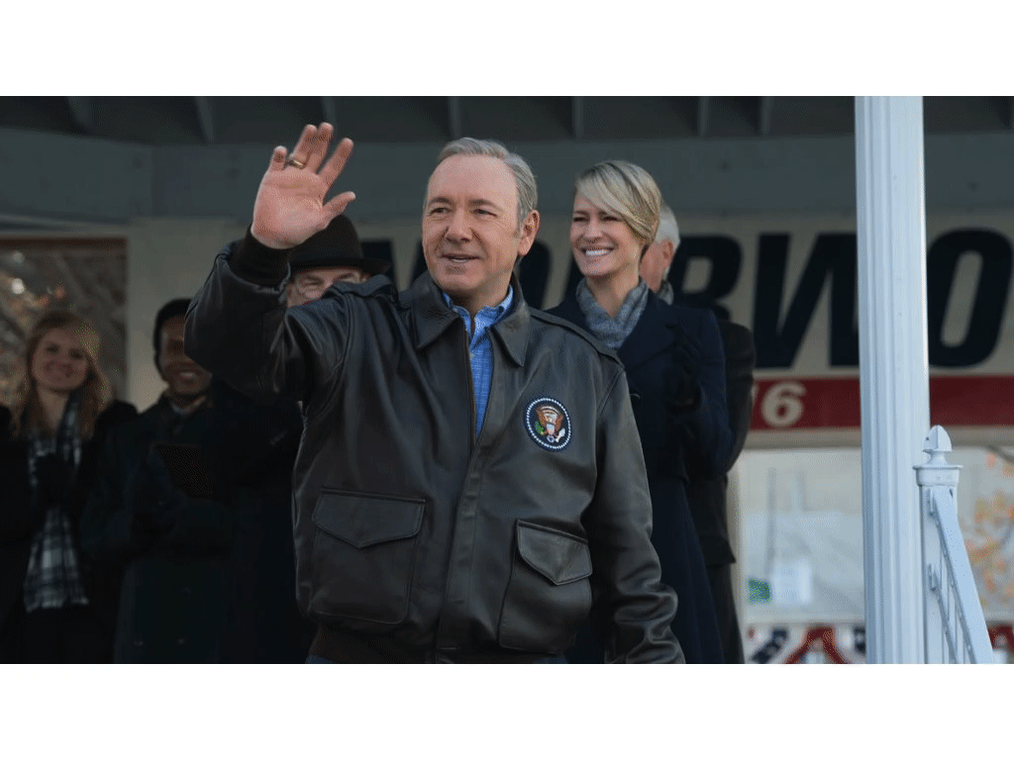
Focal Point Algorithm
Used to effectively render an image on a variety of canvases like a phone screen or TV.
Identify the most interesting region of an image, then use that information to dynamically display it.
identify all the people and their body positioning using Haar-cascade like features.
Build an algorithm that auto-selects “best’ or “most interesting” person and then focuses in on that specific location.

Slide 5
References:
Apurva Kansara
Extracting Image Meta Data at Scale
(Netflix Tech Blog)

